Slide 1
Prepared by:-
Bhojak Shyam
Branch:-
C.E( 1st Semester )
Enroll. No. :-
130590107033
Nd: YAG LASER
G.K.BHARD INSTITUTE
OF
ENGINEERING

Slide 2
1.Introduction (Brief history of laser)
The laser is perhaps the most important optical device to be developed in the past 50 years.
Since its arrival in the 1960s, rather quiet and unheralded outside the scientific community, it has provided the stimulus to make optics one of the most rapidly growing fields in science and technology today.

Slide 3
The laser is essentially an optical amplifier.
The word laser is an acronym that stands for “light amplification by the stimulated emission of radiation”.
The theoretical background of laser action as the basis for an optical amplifier was made possible by Albert Einstein, as early as 1917, when he first predicted the existence of a new irradiative process called “stimulated emission”.
His theoretical work, however, remained largely unexploited until 1954, when C.H. Townes and Co-workers developed a microwave amplifier based on stimulated emission radiation. It was called a maser.

Slide 4
2. TYPES OF LASER
Nd: YAG LASER
CO2 LASER
RUBY LASER

Slide 5
Nd YAG LASER

Slide 6
Nd (Neodymium) – YAG (Yttrium Aluminium Garnet) LASER
Principle Characteristics
Type | : | Doped Insulator Laser
Active Medium | : | Yttrium Aluminium Garnet
Active Centre | : | Neodymium
Pumping Method | : | Optical Pumping
Pumping Source | : | Xenon Flash Pump
Optical Resonator | : | Ends of rods silver coated Two mirrors partially and totally reflecting
Power Output | : | 20 kWatts
Nature of Output | : | Pulsed
Wavelength Emitted | : | 1.064 μm
Doped Insulator laser refers to yttrium aluminium garnet doped with neodymium. The Nd ion has many energy levels and due to optical pumping these ions are raised to excited levels. During the transition from the metastable state to E1, the laser beam of wavelength 1.064μm is emitted

Slide 7
OPTICAL PUMPING
The optical pumping is used to excite the atom from ground state to active state.

Slide 8
ACTIVE MEDIUM
Here the active medium is Yttrium Aluminum Granite( YAG ).
Neodymium ion( Nd ):-
It is a active center which is used for lasing mechanism.
This Nd can shift to the place of y.

Slide 9
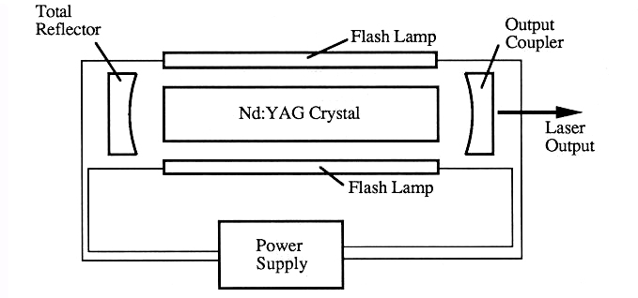

Slide 10
In the given figure, Nd YAG rod id on major
axis and Krypton flash lamp is at minor axis .
The light is continuously reflects from krypton
flash lamp and Nd YAG absorbs this light which
helps an atom to excite from lower energy state to
higher energy state.
At one end there is a perfectly reflector and at the other end there is partial reflector.

Slide 11
E3
Non-radiative
Upper
metastable
state
0.73 µm
E4
E2
Lower
metastable
state
E5
0.80 µm
Non-radiative
E1

Slide 12
When neodymium ion moves excite from lower energy state or ground state to higher energy state or excited state.
But it will not remains at the ground state for long time due to its lifetime(10⁻⁸s ). It means it will come back to ground state after its life time.
But here it goes into upper metastable state but it cannot release the energy in the form of light so, it is non- radiative transition. Here it will remains for sometime.

Slide 13
Then it goes from upper metastable state to lower metastable state, it release the photons. If there is only upper and metastable states then there will be a multiplication of photons.
Now, from it goes from lower metastable state to ground state but it cannot release the energy in the form of light..
This process takes place continuously.

Slide 14
The Nd YAG laser is a 4-Level LASER
Ground state
Exited state
Upper Metastable
state
Lower Metastable
state

Slide 15
medical applications

Slide 16
A wide application of laser in medicine and beauty therapy
Surgical laser: removing tumors, making incisions.
Cosmetic treatments: resurfacing, removal of birth mark, age spots, spider veins, hair, tattoos,
Ophthalmology: inner eye surgery in removing cataract, repairing retina, correct nearsightedness.

Slide 17
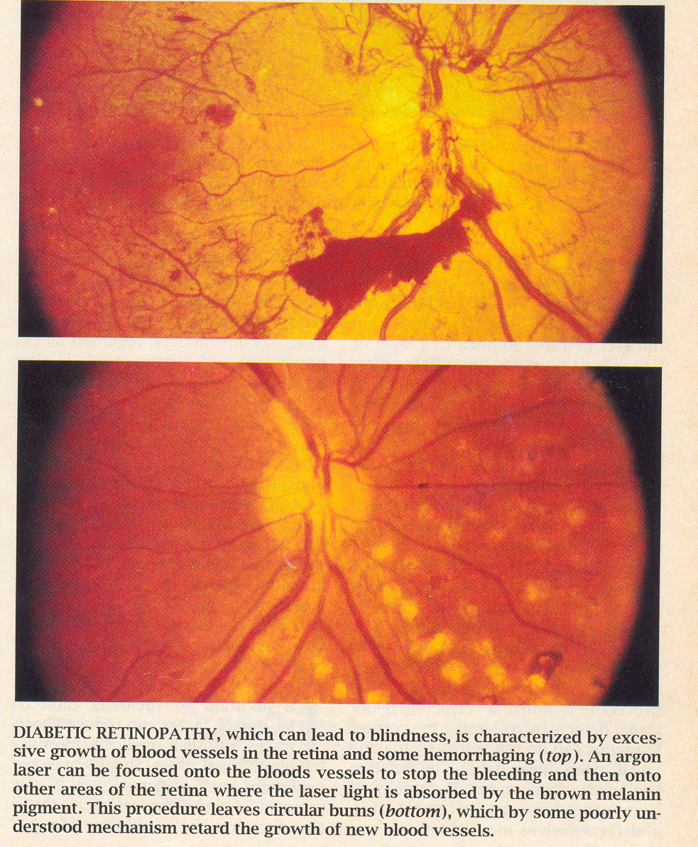
Laser repairing retina

Slide 18
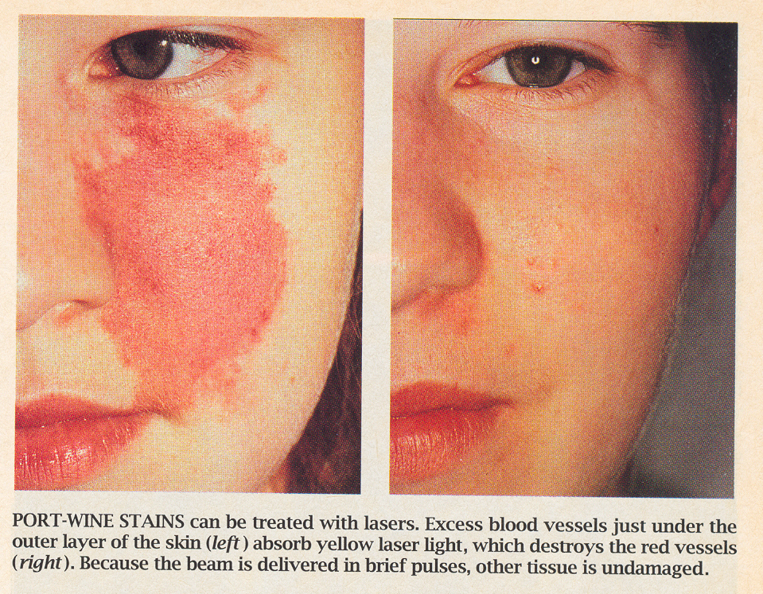
Laser removal of port-wine stain

Slide 19
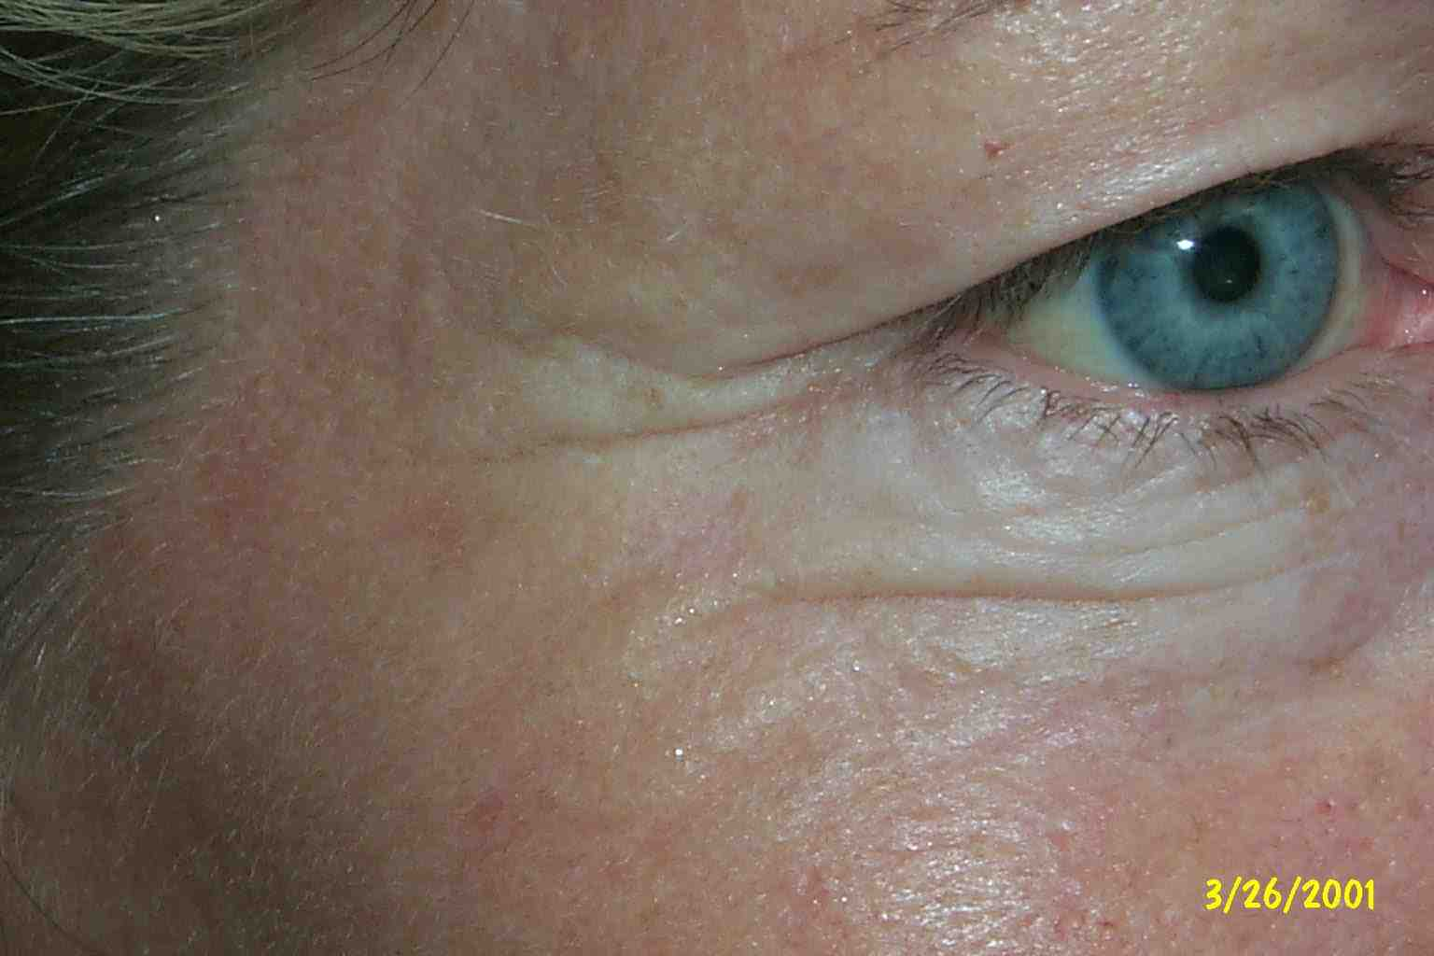
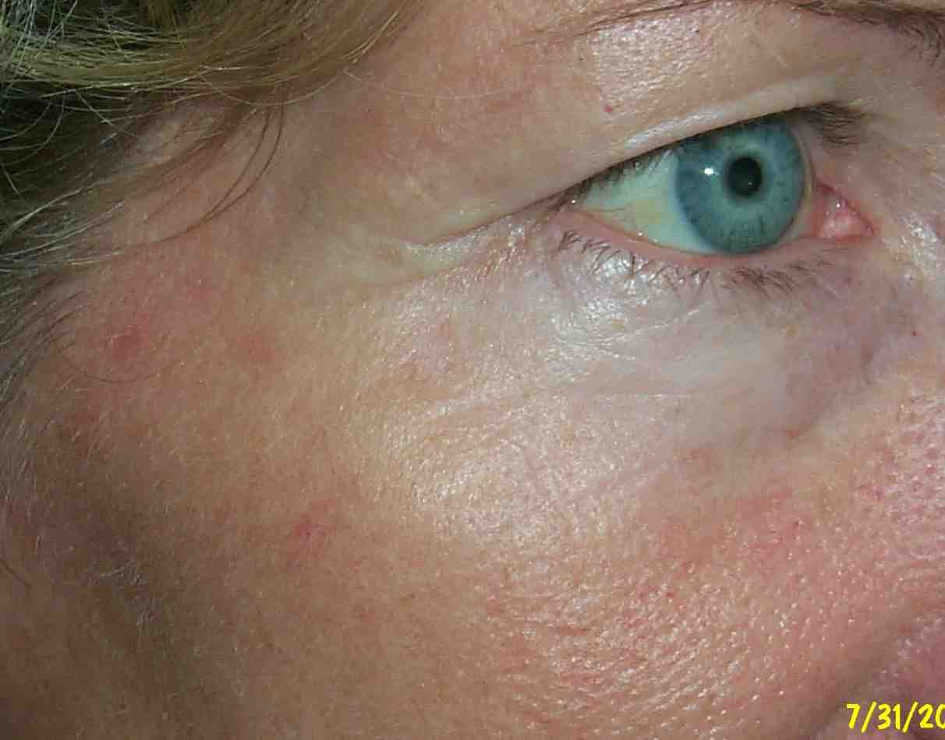
Laser skin rejuvenation

Slide 20





LASERS ARE USED IN FIBRE-OPTIC ENDOSCOPETO DETECT ULCERS IN THE INTESTINES.
LASERS ARE USED FOR BLOODLESS SURGERY.

Slide 21


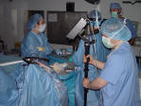
Lasers are used extensively in the treatment of eye-diseases ,particularly to reattach a detached retina.
The liver and lung diseases could be treated by lasers.

Slide 22
SCIENCE AND TECHNOLOGY

Slide 23
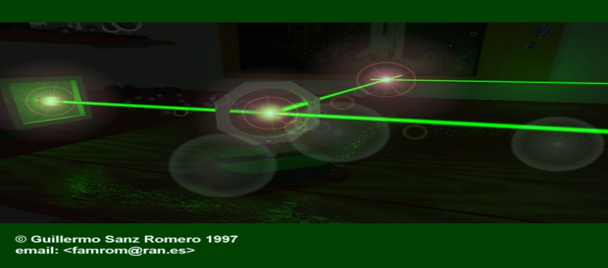


1.LASERS HELPED IN UNDERSTANDING AND OFFERING CLARIFICATIONS FOR MANY BASIC PROBLEMS OF SCIENCE AND TECHNOLOGY
2.WITH THE HELP OF HE-NE LASER,IT WAS PROVED THAT THE VELOCITY OF LIGHT IS SOME IN ALL
DIRECTIONS.
3.IN ASTRONOMY, LASERS HELPED IN EXTENDING THE DISTANCE OF OBSERVATION OF STELLAR OBJECTS AND STUDY THEIR NATURE.

Slide 24

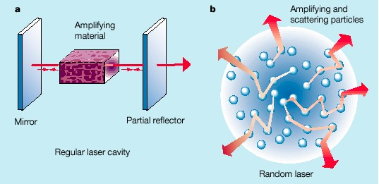

THE COUNTING OF ATOMS IN A SUBSTANCE BECAME POSSIBLE BECAUSE OF LASER.
IN COMPUTERS, LASERS ARE USED TO RETRIEVE STORED INFORMATION FORM A COMPACT DISC(CD)

Slide 25
INDUSTRIES

Slide 26

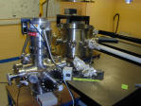
LASERS ARE USED NOW FOR CUTTING, DRILLING AND WELDING OF METALS AND OTHER MATERIALS.
LASER LIGHT IS USED TO COLLECT THE INFORMATION ABOUT THE PREFIXED PRICES OF VARIOUS PRODUCTS IN SHOPS AND BUSINESS ESTABLISHMENTS FROM THE BAR-CODE PRINTED ON THE PRODUCT.

Slide 27
DEFENCE AND SPACE SCIENCE

Slide 28

LASER ARE USED IN SPACE COMMUNICATION, IN RADARS AND IN SATELLITES.

Slide 29


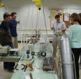

LASERS ARE USED IN VARIOUS GUIDED MISSILES AND ALSO FOR DETECTION OF ENEMY TARGETS.

Slide 30




NOWADAYS, A STUDENT CAN FLY A PLANE WITH THE HELP OF LASER RAYS. MAN HAS INVENTED TO FLY A PLANE WITHOUT USING ANY FUAL.
LASER IS USEFUL TO MANKIND IN MANY WAYS. IN FUTURE, MANY UNBELIEVABLE THINGS ARE GOING TO HAPPEN WITH THE USE OF LASER RAYS.

Slide 31


